Slide 1
Phase 1
Clark Donnell

Slide 2
Demo
https://clarkdonnell.pythonanywhere.com/

Slide 3
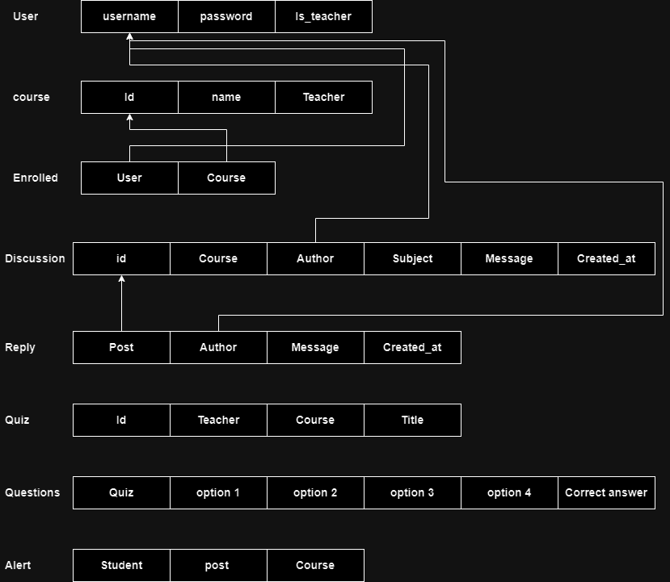

Slide 4
Thank You

